Slide 1
Intent
An intent is an abstract description of an operation to be performed.
An Intent is a messaging object you can use to request an action from another app component.
Notes:
https://www.vogella.com/tutorials/AndroidIntent/article.html#sending-out-explicit-or-implicit-intents

Slide 2
Intent
Although intents facilitate communication between components in several ways, there are three fundamental use cases:
Starting an activity
Starting a service
Delivering a broadcast

Slide 3
Intent: Starting an Activity
An Activity represents a single screen in an app. You can start a new instance of an Activity by passing an Intent to startActivity(). The Intent describes the activity to start and carries any necessary data.
If you want to receive a result from the activity when it finishes, call startActivityForResult(). Your activity receives the result as a separate Intent object in your activity's onActivityResult() callback.

Slide 4
Intent: Starting a Service
A Service is a component that performs operations in the background without a user interface.
You can start a service to perform a one-time operation (such as downloading a file) by passing an Intent to startService().
The Intent describes the service to start and carries any necessary data.

Slide 5
Intent: Delivering a Broadcast
A broadcast is a message that any app can receive.
The system delivers various broadcasts for system events, such as when the system boots up or the device starts charging.
You can deliver a broadcast to other apps by passing an Intent to sendBroadcast() or sendOrderedBroadcast().

Slide 6
Intent Types
Explicit intents
Implicit intents

Slide 7
Intent Types: Explicit Intents
Explicit intents specify which application will satisfy the intent, by supplying either the target app's package name or a fully-qualified component class name.
You'll typically use an explicit intent to start a component in your own app, because you know the class name of the activity or service you want to start.
For example, you might start a new activity within your app in response to a user action, or start a service to download a file in the background.

Slide 8
Intent Types: Implicit Intents
Implicit intents do not name a specific component, but instead declare a general action to perform, which allows a component from another app to handle it.
For example, if you want to show the user a location on a map, you can use an implicit intent to request that another capable app show a specified location on a map.

Slide 9
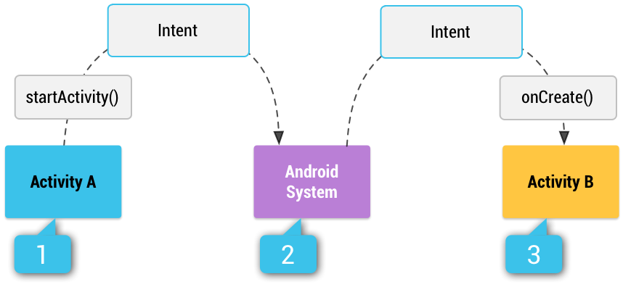
Intent Types: Implicit Intents
How an implicit intent is delivered through the system to start another activity?
[1] Activity A creates an Intent with an action description and passes it to startActivity().
[2] The Android System searches all apps for an intent filter that matches the intent. When a match is found,
[3] the system starts the matching activity (Activity B) by invoking its onCreate() method and passing it the Intent.

Slide 10
Intent Structure
The primary pieces of information in an intent are:
action -- The general action to be performed.
data -- The data to operate on, such as a person record in the contacts database, expressed as a Uri.

Slide 11
Intent Action Examples
ACTION_VIEW
Use this action in an intent with startActivity() when you have some information that an activity can show to the user, such as a photo to view in a gallery app, or an address to view in a map app.
ACTION_SEND
Also known as the share intent, you should use this in an intent with startActivity() when you have some data that the user can share through another app, such as an email app or social sharing app.

Slide 12
Implicit Intent Example
//Google maps through intent.
Intent intent = new Intent(android.content.Intent.ACTION_VIEW, Uri.parse("http://maps.google.com/maps?saddr=20.344,34.34&daddr=20.5666,45.345")); startActivity(intent);
//SMS through intent.
String number = "12346556"; // The number on which you want to send SMS startActivity(new Intent(Intent.ACTION_VIEW, Uri.fromParts("sms", number, null)));
//Opening browser through intent
String url = "http://www.example.com"; Intent i = new Intent(Intent.ACTION_VIEW); i.setData(Uri.parse(url)); startActivity(i);

